Slide 1
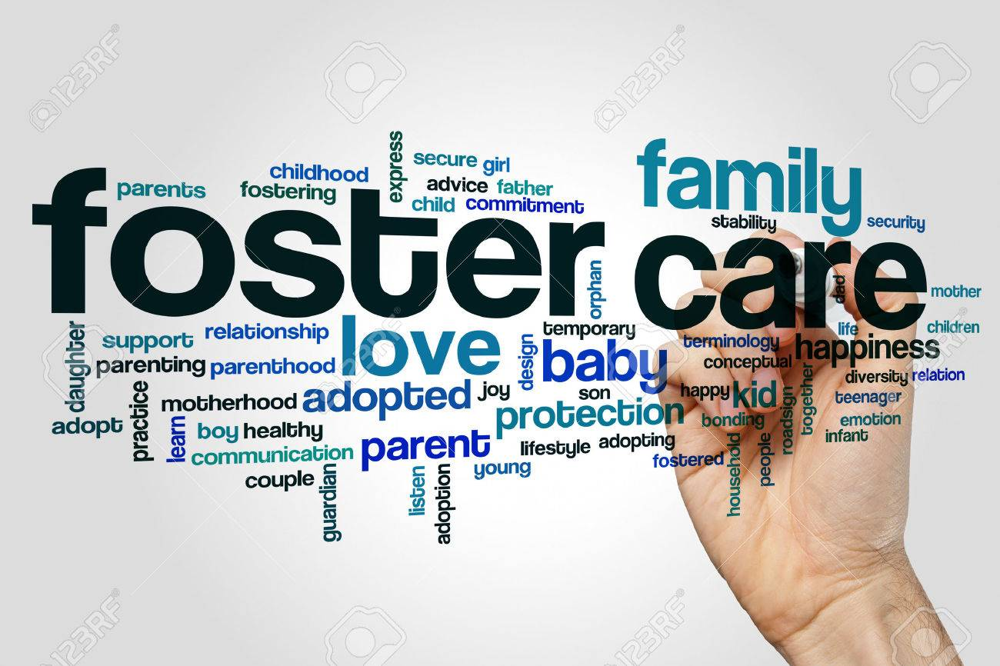
Foster Care Analysis
A an investigation of foster care data using python and tableau
By: Kyle Hommes

Slide 2

Project Links:
Github:
https://github.com/kylehommes/FosterCare
Tableau Dashboard:
https://public.tableau.com/profile/kyle.hommes#!/vizhome/FosterCareProject/Services?publish=yes
Project Website:
https://fostercareanalysis.wordpress.com

Slide 3
Project Overview
Data:
The data for this project came from the Nation Youth in Transition Dataset which is part of the National Data Archive for Child Abuse and Neglect at Cornell University. It consists of survey data from a series of evaluations done with youth transitioning out of the foster care system. The data was mainly categorical in nature and consisted of outcomes data, data on the services with which the youth were involved, and demographic data.
Analysis:
The analysis of the data was done in Python and the visualization of the data was completed using Tableau. The categorical data from the surveys was transformed using a scoring system to aid in the Exploratory Data Analysis and help gain insight into the trends within the data. Then, machine learning was used to predict homelessness based on the services that the youth were involved with and the youth were organized into clusters using K-means clustering.
Outcome:
The visualization dashboard showed various trends within the data including differences in outcomes based on state and level of involvement in the foster care system. The K-means clustering analysis created a large group of the surveyed youth that had outcomes scores below the mean and split the youth with outcomes scores over the mean into several groups. For the machine learning process, Decision Tree algorithm was used, which accomplished an accuracy of 88.36% for the model.

Slide 4
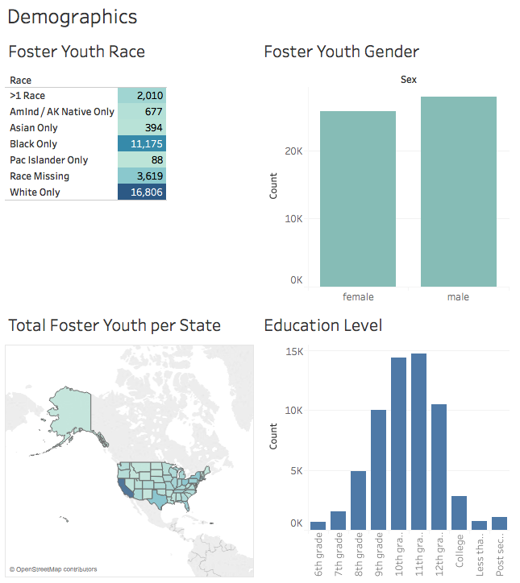

Exploratory Data Analysis
with
Tableau

Slide 5
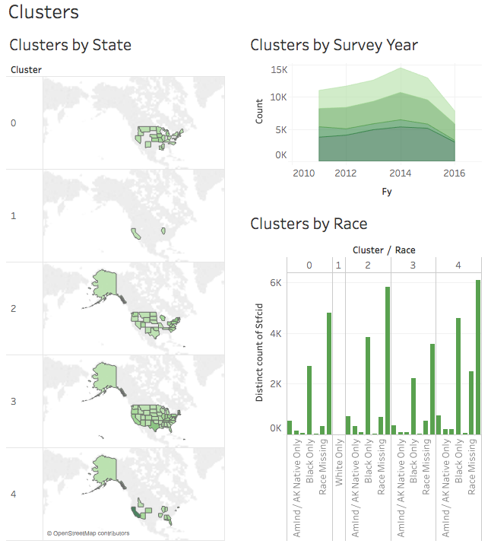
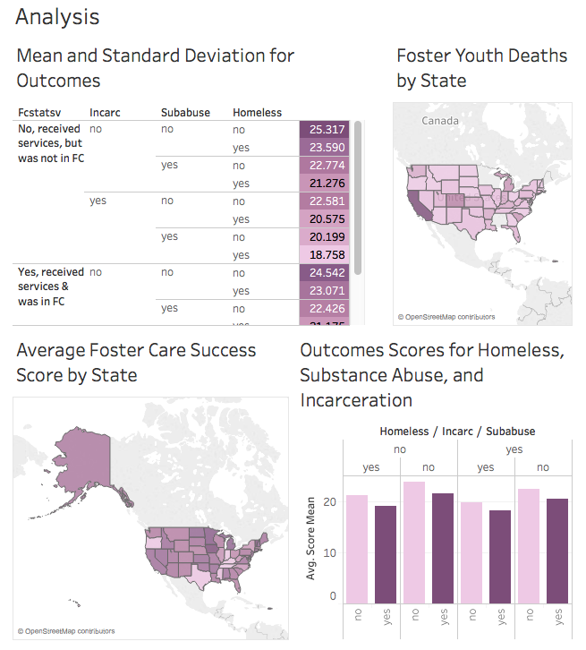
Visualizations

Slide 6
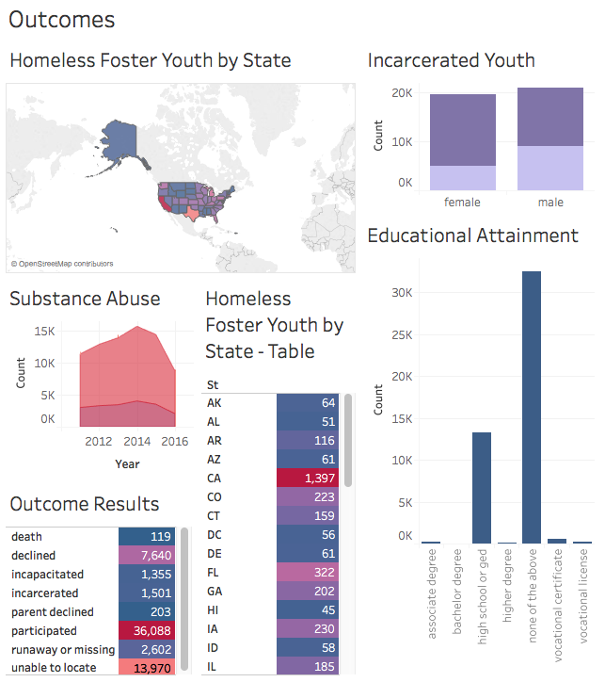
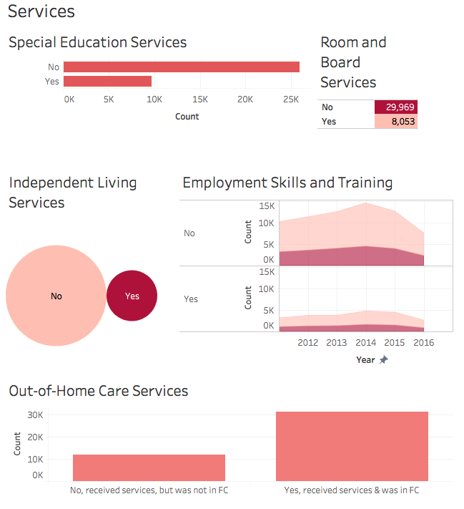
Visualizations

Slide 7
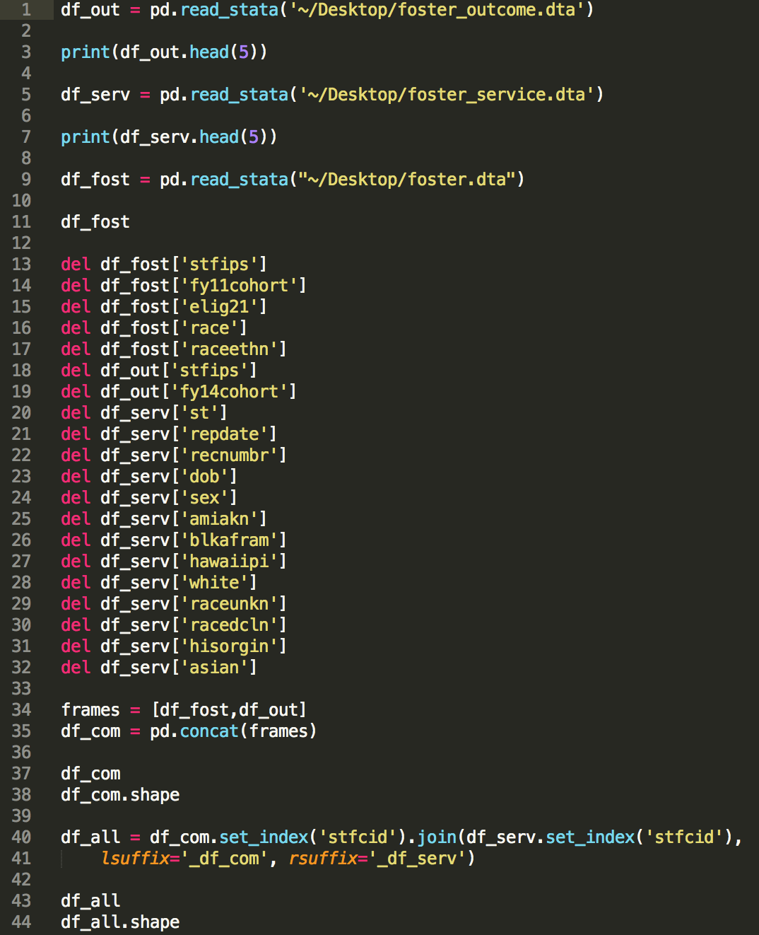
Data Wrangling
3 different Stata files from the National Youth in Transition Dataset were loaded into Python and joined using the Pandas library.

Slide 8
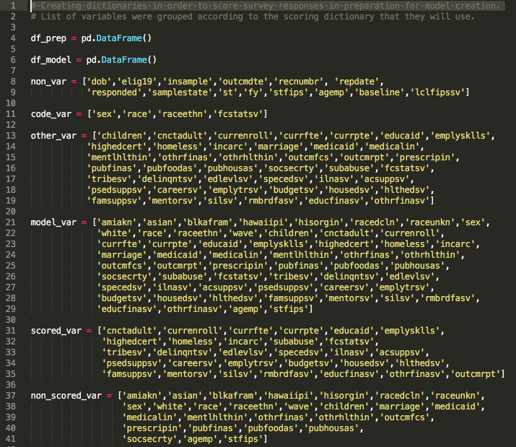
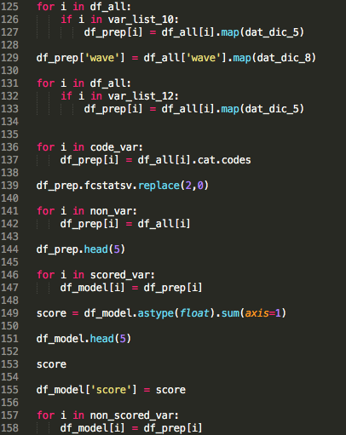
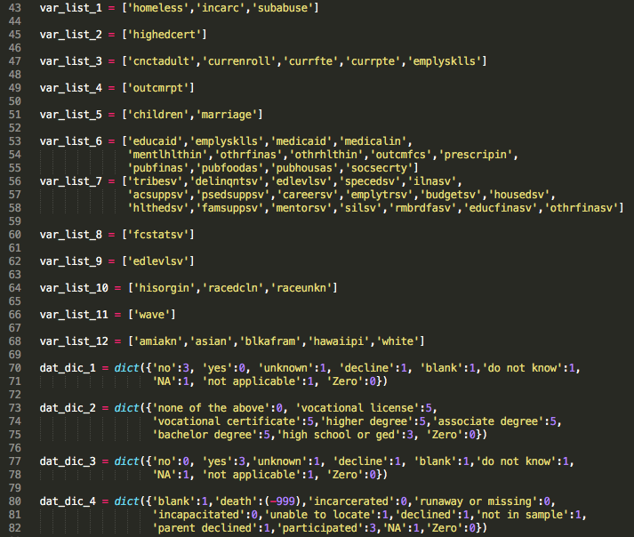
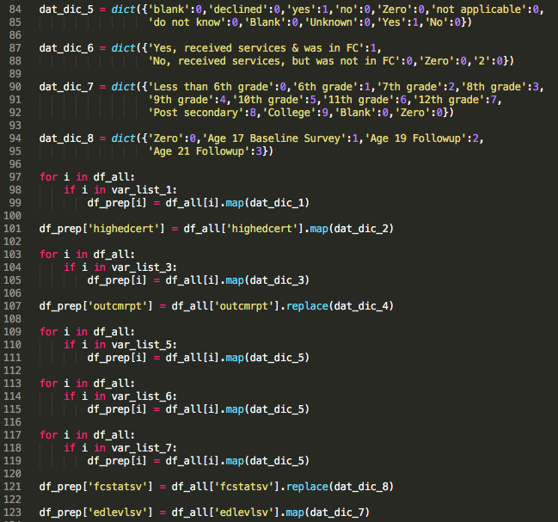
Scoring Categorical Variables
All of the categorical variables in the dataset were scored as values using a python dictionary to map out which categories matched up to their corresponding values

Slide 9
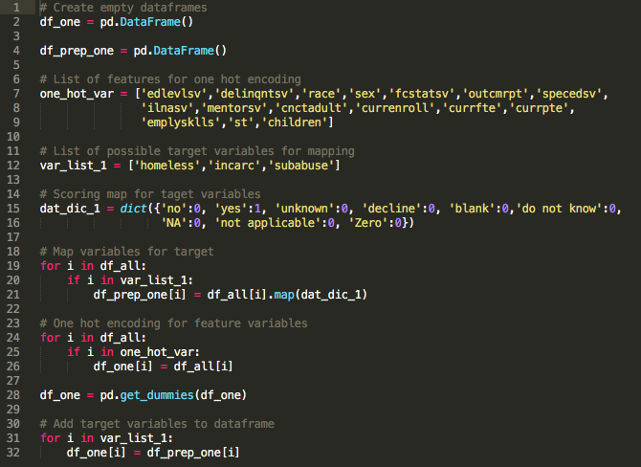
One Hot Encoding
The feature variables for the machine learning model were prepped using one hot encoding.

Slide 10

Machine Learning
With Python

Slide 11
Attempts at Modeling
Accuracy of machine learning algorithms with the scored categorical data predicting success label
Accuracy of machine learning algorithms with the one hot encoded data predicting homelessness
Algorithm | Accuracy
Linear Regression | 23.31%
Linear Discriminant Analysis | 96.44%
K-Nearest Neighbor | 71.69%
Naïve Bayes | 78.26%
Decision Tree | 99.99%
Suppor Vector Machine | 96.22%
Algorithm | Accuracy
Linear Regression | 85.96%
Linear Discriminant Analysis | 85.86%
K-Nearest Neighbor | 87.03%
Naïve Bayes | 50.68%
Decision Tree | 88.30%
Suppor Vector Machine | 85.66%

Slide 12
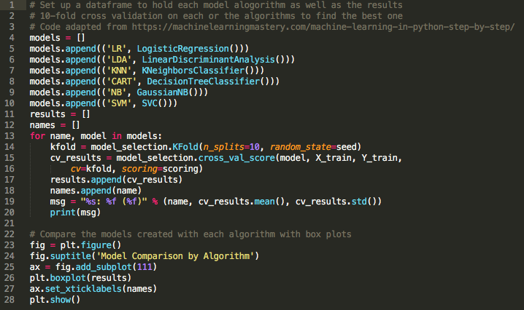
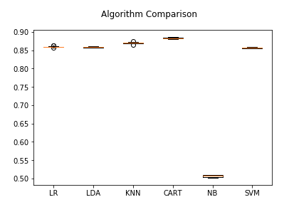
10-Fold
Cross Validation
Investigated 6 different algorithms
The Decision Tree Algorithm exhibited the best results
Graphed the boxplots of the validation scores

Slide 13
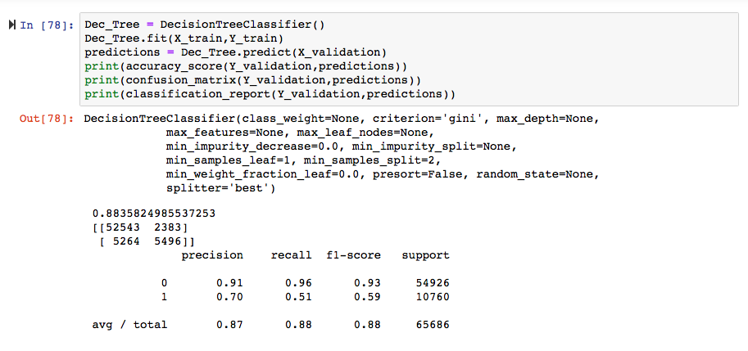
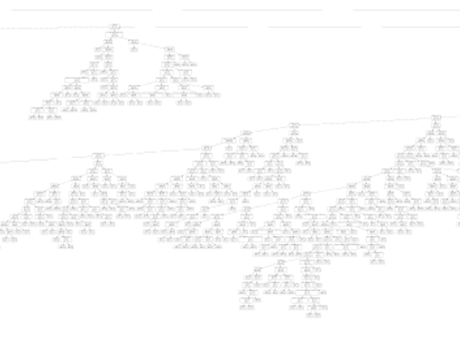
Decision Tree Classifier
Snapshot of a portion of the decision tree created by the model

Slide 14
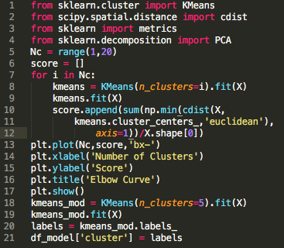
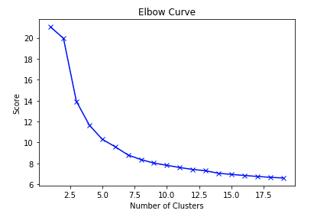
K-Means
Clustering
Code for K-means Analysis
Cluster Visualizations
Elbow Plot for K-means

Slide 15

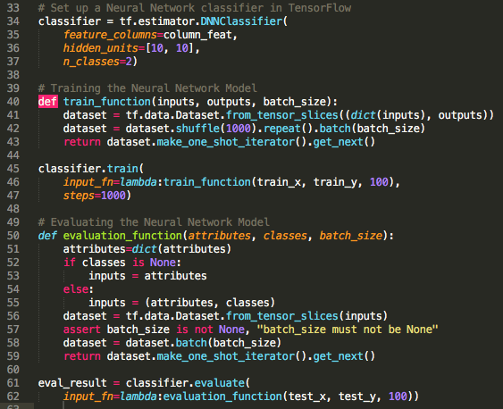
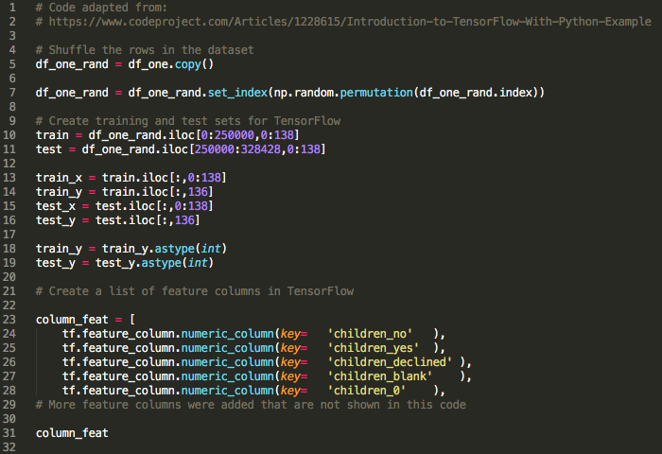
TensorFlow - Deep Neural Network
The data was loaded into Tensor Flow and a Deep Neural Network Model was created that exhibited an accuracy of 81.46%
Results
INFO:tensorflow:Saving dict for global step 1000: accuracy = 0.81459427, accuracy_baseline = 0.80049217, auc = 0.80586296, auc_precision_recall = 0.48508084, average_loss = 0.39649075, global_step = 1000, label/mean = 0.19950783, loss = 39.61271, precision = 0.565677, prediction/mean = 0.20739768, recall = 0.3044034

Slide 16
Summary
Exploratory Data Analysis illuminated the demographic layout, outcomes, and services for the foster youth involved in the surveys
With an observation rate of 87.53% of the foster youth responses not indicating homelessness, the decision tree model only exhibited a slight improvement above the observation rate
The categorical variables in the data and missing survey responses complicated the analysis
Combining the data into one dataset for modeling purposes caused some difficulties with respect to interpreting the results
Possibilities for
Further Investigation
By looking at the datasets separately or breaking them into survey waves, more insights could be gained
A closer look at the K-means clusters could reveal similarities in the way states serve foster youth
A more advanced weighting technique for the categorical variables could increase the predictive power of the model and aid in Exploratory Data Analysis

Slide 17
References and Useful Links
https://www.codeproject.com/Articles/1228615/Introduction-to-TensorFlow-With-Python-Example
https://www.ndacan.cornell.edu/datasets/datasets-list-nytd.cfm
https://www.analyticsvidhya.com/blog/2016/01/complete-tutorial-learn-data-science-python-scratch-2/
http://www.nathan-rice.net/eda-python/
https://machinelearningmastery.com/machine-learning-in-python-step-by-step/
http://www.michaeljgrogan.com/k-means-clustering-python-sklearn/

